Slide 1
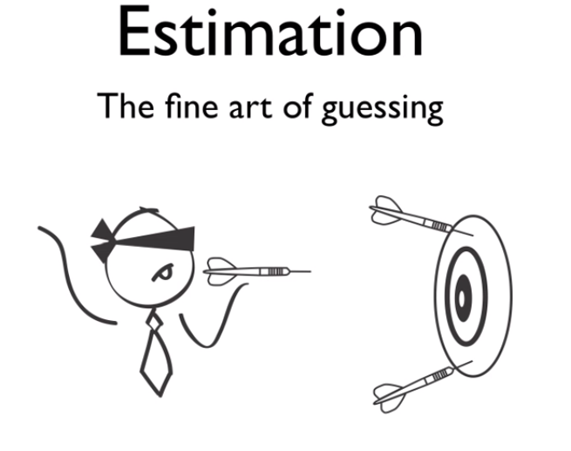

Slide 2
One of the main objectives of statistics is to draw inferences about a population from the analysis of a sample drawn from that population.
Two important problems are: Estimation and Testing of Hypothesis.
The theory of Estimation was founded by Prof R.A Fisher in 1930.

Slide 3
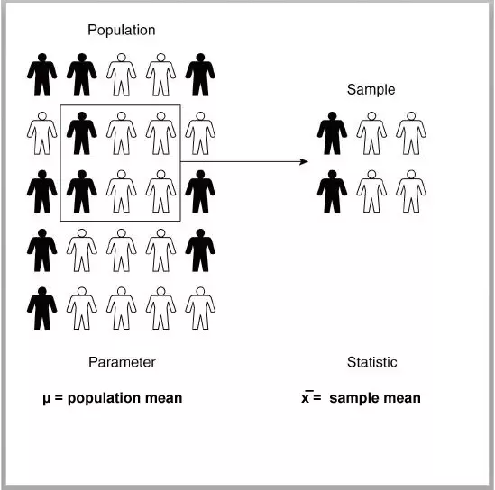
Basic Terminology
Population: any collection of entities that have at least one characteristic in common
Parameter: the numbers that describe characteristics of scores in the population (mean, variance, s.d., etc.)

Slide 4
Basic Terminology
Sample: a part of the population
Statistic: the numbers that describe characteristics of scores in the sample (mean, variance, s.d., correlation coefficient, reliability coefficient, etc.)

Slide 5
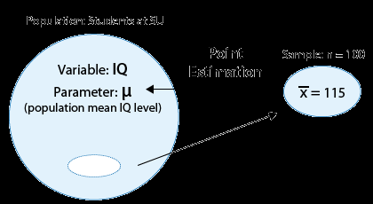
Basic Terminology
Estimate: a number computed by using the data collected from a sample.
Estimator: formula used to compute an estimate

Slide 6
An estimator is a statistic that estimates some fact about the population. You can also think of an estimator as the rule that creates an estimate. For example, the sample mean(x̄) is an estimator for the population mean, μ.
The quantity that is being estimated (i.e. the one you want to know) is called the estimand.

Slide 7

For example, let’s say you wanted to know the average height of children in a certain school with a population of 1000 students.
You take a sample of 30 children, measure them and find that the mean height is 56 inches.
This is your sample mean, the estimator. You use the sample mean to estimate that the population mean (your estimand) is about 56 inches.

Slide 8
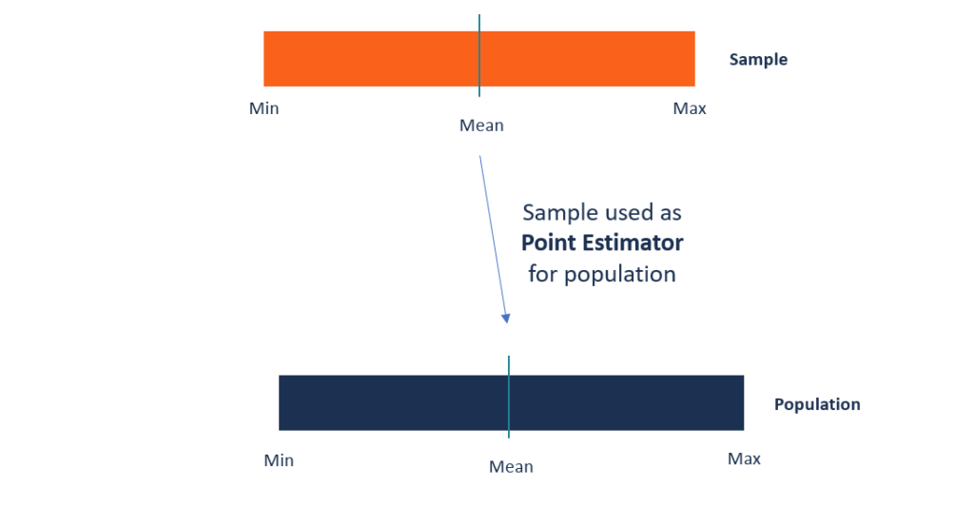
It is also common to use estimation in situations where a researcher simply wants to learn about an unknown population.
In this case, a sample is selected from the population and the sample data are then used to estimate the population parameters.

Slide 9

There are two forms of estimation:
Point estimation (maximally likely value for parameter)
Interval estimation (also called confidence interval for parameter)
A point estimate is a single number. Whereas, a confidence interval, naturally, is an interval.

Slide 10
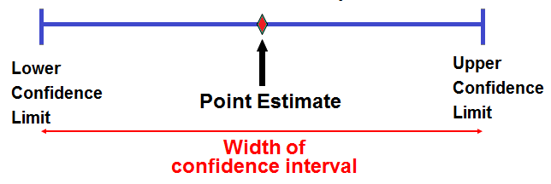

Slide 11

Point estimators are not very reliable, as you can guess. Imagine visiting 5% of the restaurants in London and saying that the average meal is worth 22.50 pounds

Slide 12

You may be close, but chances are that the true value isn’t really 22.50 but somewhere around it. When you think about it, it’s much safer to say that the average meal in London is somewhere between 20 and 25 pounds. In this way, you have created a confidence interval around your point estimate of 22.50!

Slide 13
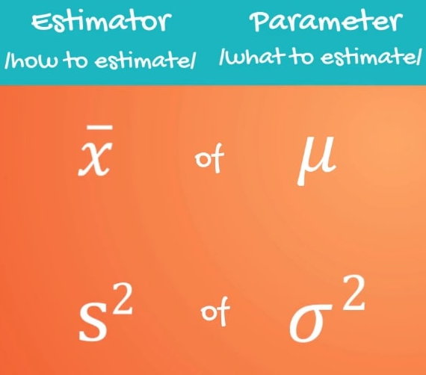
Point estimates are single points that are used to infer parameters directly. For example,
• Sample proportion pˆ (“p hat”) is the point estimator of p
• Sample mean x (“x bar”) is the point estimator of μ
• Sample standard deviation s is the point estimator of σ

Slide 14
Imagine that you are given a dataset with a sample mean of 10.
In this case, is 10 a point estimate or an estimator?
Of course, it is a point estimate. It is a single number given by an estimator.
Here, the estimator is a point estimator and it is the formula for the mean.

Slide 15
Notice the use of different symbols to distinguish estimators and parameters.
More importantly, point estimates and parameters represent fundamentally different things.
Point estimates are calculated from the data; parameters are not.
Point estimates vary from study to study; parameters do not.
Point estimates are random variables: parameters are constants.

Slide 16
POINT ESTIMATION
Here, we assume that θ is an unknown parameter to be estimated.
For example, θ might be the expected value of a random variable, θ=E[X].
To estimate θ, we need to collect some data. Specifically, we get a random sample X₁, X₂, X₃, ..., X_{n} such that Xi's have the same distribution as X.
To estimate θ, we define a point estimator Θ to be the sample mean

Slide 17
There are infinitely many possible estimators for θ, so how can we make sure that we have chosen a good estimator?
How do we compare different possible estimators?
To do this, we provide a list of some desirable properties that we would like our estimators to have.
Intuitively, we know that a good estimator should be able to give us values that are "close" to the real value of θ.

Slide 18
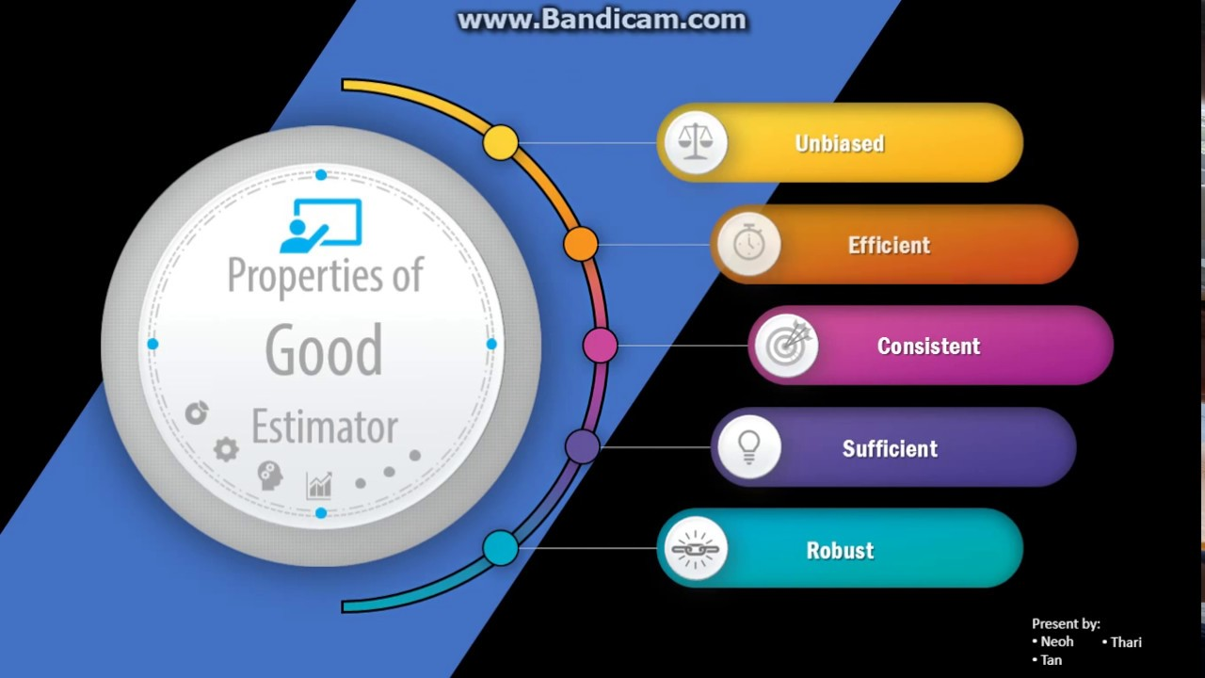

Slide 19
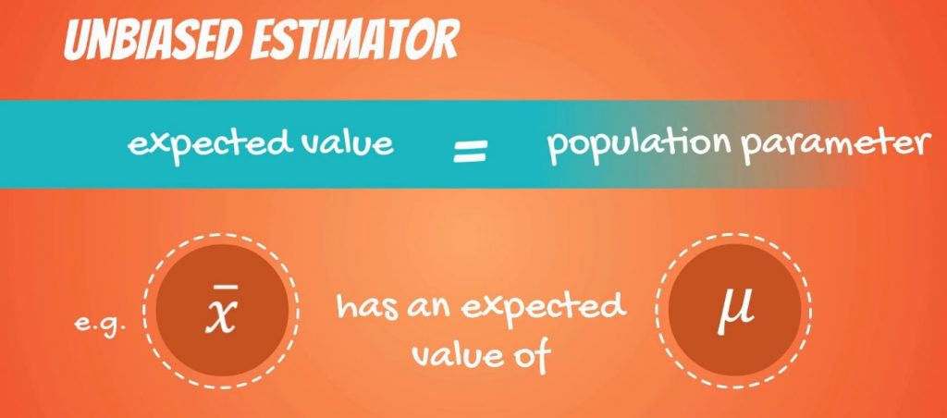
UNBIASEDNESS
An unbiased estimator has an expected value equal to the population parameter.

Slide 20
An unbiased estimator is an accurate statistic that’s used to approximate a population parameter.
“Accurate” in this sense means that it’s neither an overestimate nor an underestimate.
If an overestimate or underestimate does happen, the mean of the difference is called a “bias.”
if the estimator (i.e. the sample mean) equals the parameter (i.e. the population mean), then it’s an unbiased estimator.

Slide 21
Consider a sample of n independent draws from a normal population having unknown µ and variance σ²
As an estimator of the mean, we use the sample mean.

Slide 22
To prove mean is an unbiased estimator, we will prove

Slide 23
To prove variance is a unbiased estimator, we will prove
Where population variance is
And sample variance is

Slide 24
Prove that median is unbiased estimator for Normal distribution with parameter µ and σ
Let X₁,X₂………X_{n} be the sample . Let Yi=Xi-µ
By symmetry of the distribution of the Ys about 0,
−m=E(−median)=E(median)=m
Since m=−m, we must have m=0.
Since E(median)=0,
we conclude
E(median(X1,…,Xn)) =E(median(Y1+μ,…,Yn+μ)) =E(μ+median(Y1,…,Yn))=E(μ)=μ

Slide 25
Can a sample proportion X/n be considered as an unbiased estimator of p, where the random variable X is the no. of Successes has binomial distribution with parameter n and p.
Hence a sample proportion X/n can be considered as an unbiased estimator of p

Slide 26
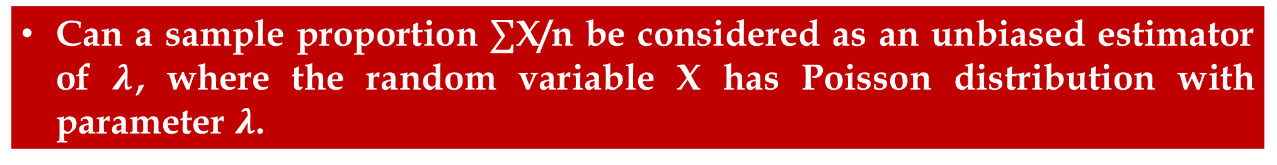
Can a sample proportion $∑$X/n be considered as an unbiased estimator of $λ$, where the random variable X has Poisson distribution with parameter $λ$.

Slide 27

CONSISTENCY
An estimator of a given parameter is said to be consistent if it converges in probability to the true value of the parameter as the sample size tends to infinity.
In other words, the more data you collect, a consistent estimator will be close to the real population parameter you’re trying to measure.
The sample mean and sample variance are two well-known consistent estimators.

Slide 28
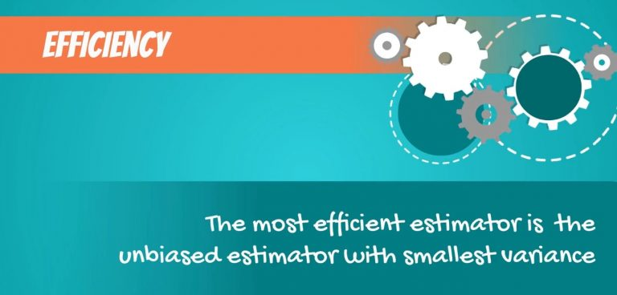
EFFICIENCY
The most efficient estimators are the ones with the least variability of outcomes.
It is enough to know that most efficient means: the unbiased estimator with the smallest variance.

Slide 29
EFFICIENCY
Among a number of estimators of the same class, the estimator having the least variance is called an EFFICIENT ESTIMATOR.
Thus, if we have two estimators α₁ and α₂ with variances Var(α₁) and Var(α₂) respectively, and if Var(α₁)<Var(α₂), then α₁ will be an efficient estimator.
The ratio of the variances of two estimators denoted by e(α₁,α₂) is known as the efficiency of α₁ and α₂ is defined as follows:
e(α₁,α₂)=Var(α₂)/Var(α₁)

Slide 30
Example: Consider a sample from Normal Distribution. Prove that For Normal Distribution, sample mean is more efficient than sample median
Mean is more efficient than Median.

Slide 31
SUFFICIENCY
An estimator of a parameter θ which gives as much information about θ as is possible from the sample at hand is called a sufficient estimator.
Such as the sample mean . The actual sample values are no longer important to us. That is, if we use a sample mean of 3 to estimate the population mean μ, it doesn't matter if the original data values were (1, 3, 5) or (2, 3, 4)
Sufficiency is an important quality in hypothesis testing where we are effectively comparing the distribution under the null hypothesis with the actually observed distribution.
Application of sufficiency is to show quite generally that nothing is lost in terms of risk if we base decisions on a sufficient statistic.

Slide 32

SUFFICIENCY
If sufficient estimator exists, it is absolutely unnecessary to consider any other estimator.
For normal distribution mean and median are unbiased estimators. However median uses rank so it is not sufficient while sample mean considers each member of the sample as well as its size so it is sufficient statistics.

Slide 33
How to find estimators?
Method of Estimation
Method of Least square
Method of Moments
Method of Maximum Likelihood estimation

Slide 34
Least Square method
It was defined by A.M. Lagendre, K. F. Gauss and A. A. Markow; it’s most commonly used to estimate parameters in the linear model regressions. It is sensitive to outliers.
This is called least squares estimation because it gives the least value for the sum of squared errors. Finding the best estimates of the coefficients is often called “fitting” the model to the data, or sometimes “learning” or “training” the model.

Slide 35
Suppose X₁,X₂,X₃…..X_{n} is a random sample of the population whose parameter θ is the mean of the population which is unknown.
Then the reasonable estimate of θ can be found by considering the sum of squares of the differences.
As small as possible. Where (Xi- θ ) is the error term in fitting the regression line.
The concept of minimize the sum of squared differences between observed data and expected data is known as the principle of least squares.

Slide 36
Example: Suppose observation 3,4,8 are collected in a random sample of size 3 from a population with unknown θ . Then
To minimize S consider
Cleary for θ=5, S is minimum.
Therefore θ=5 is mean i.e required estimate of the population.
θ | 0 | 1 | 2 | 3 | 4 | 5 | 6 | 7 | ……
S | 89 | 62 | 41 | 26 | 17 | 14 | 17 | 26 | ……

Slide 37
In general
Which is a quadratic function in θ.
To minimize the S
i.e Sample mean is a least square estimate of population mean θ

Slide 38
Method of Moments
The Method of Moments is a simple technique based on the idea that the sample moments are “natural” estimators of population moments
Advantage: simplest approach for constructing an estimator
Disadvantage: usually are not the “best” estimators possible
Principle: Equate the k^{th} population moment with the k^{th} sample moment and solve for the unknown parameter

Slide 39
E(X^{k})=k^{th} theoretical moment of distribution about origin.
E((X-µ)^{k})=k^{th} theoretical moment of distribution about mean.
K^{th} sample moment about origin.
K^{th} sample moment about mean.

Slide 40
Basic Concepts of Method of Moments
Equate first sample moment about origin to first theoretical moment i.e.
Equate Second sample moment about origin to second theoretical moment i.e.
Continue equating sample moments about origin with respective theoretical moment until we get the number of equations to be equal to the number of parameters.
Solve these equations of parameters.
Resulting values are called method of moments estimators.

Slide 41
Let X₁, X₂………X_{n} be Binomial variables with parameter p . What is the method of moments estimator of p?
Here, the first theoretical moment about the origin is: In Binomial Distribution, theoretical Moment = E(X)=p.
We have just one parameter for which we are trying to derive the method of moments estimator. Therefore, we need just one equation. Equating the first theoretical moment about the origin with the corresponding sample moment, we get:
Now, we just have to solve for p. Whoops! In this case, the equation is already solved for p. Our work is done! We just need to put a hat (^) on the parameter to make it clear that it is an estimator. We can also subscript the estimator with an "MM" to indicate that the estimator is the method of moments estimator:

Slide 42
Let X₁, X₂, ..., X_{n} be normal random variables with mean μ and variance σ². What are the method of moments estimators of the mean μ and variance σ²?
The first and second theoretical moments about the origin are:
E(X_{i}) = μ and E(X_{i}²) = σ² + μ²
(Incidentally, in case it's not obvious, that second moment can be derived from manipulating the shortcut formula for the variance.) In this case, we have two parameters for which we are trying to derive method of moments estimators. Therefore, we need two equations here. Equating the first theoretical moment about the origin with the corresponding sample moment, we get:
And, equating the second theoretical moment about the origin with the corresponding sample moment, we get:

Slide 43
Now, the first equation tells us that the method of moments estimator for the mean μ is the sample mean
And, substituting the sample mean in for μ in the second equation and solving for σ², we get that the method of moments estimator for the variance σ² is

Slide 44
Let three observations were collected on a continuous uniform random variable U(0,θ) where parameter θ is unknown. The data recorded were 3.2, 2.9, 13.1
Sample mean
Mean of Uniform Distribution is
By method of moments
Which means that the probability model defined must take values only over the range [0,12.8] and it will not permit 13.1.
Yet that was the value obtained in the sample .

Slide 45
An area of soil was divided into 240 regions of equal area called quadrants and in each quadrant the number of colonies of bacteria found was counted. The data was given in the table below:
Here precise record about the sample is not kept. Therefore Method of Moment is not applicable as mean can not be calculated.
In such cases MLE is adopted.
Count | 0 | 1 | 2 | 3 | 4 | 5 | >5
Frequency | 11 | 37 | 64 | 55 | 37 | 24 | 12

Slide 46
Maximum likelihood is a relatively simple method of constructing an estimator for an unknown parameter θ.
It was introduced by R. A. Fisher, a great English mathematical statistician, in 1912. Maximum likelihood estimation (MLE) can be applied in most problems, it has a strong intuitive appeal, and often yields a reasonable estimator of θ.
Furthermore, if the sample is large, the method will yield an excellent estimator of θ. For these reasons, the method of maximum likelihood is probably the most widely used method of estimation in statistics.

Slide 47
Method of Maximum Likelihood Estimation
Suppose we have a random sample X₁, X₂,..., X_{n} whose assumed probability distribution depends on some unknown parameter θ
If Xi's are discrete, then the likelihood function is defined as the product
If Xi's are jointly continuous, then the likelihood function is defined as
In some problems, it is easier to work with the log likelihood function given by

Slide 48
The maximum likelihood estimate (mle) of θ is that value of θ that maximizes lik(θ): it is the value that makes the observed data the “most probable”.
Rather than maximizing this product which can be quite tedious, we often use the fact that the logarithm is an increasing function so it will be equivalent to maximize the log likelihood:

Slide 49
Poisson Distribution

Slide 50
To maximize it

Slide 51
Exponential Distribution

Slide 52
Problems
Suppose that we have observed the random sample X₁, X₂, X₃, ..., X_{n}, where X_{i}∼N(θ₁,θ₂), so
Find the maximum likelihood estimators for θ₁ and θ₂.

Slide 53
Problems
A coin is flipped 100 times. Given that there were 55 heads, find the maximum likelihood estimate for the probability p of heads on a single toss.

Slide 54
Problems
A city dispute center that settles disputes per month follows a Poisson distribution. The following table gives the number of disputes settled in a month. Determine the maximum likelihood estimator.
Number of Disputes 1 2 3 4 5 6 7 8 9 10
Frequency 2 11 18 6 24 3 10 9 7 10

Slide 55
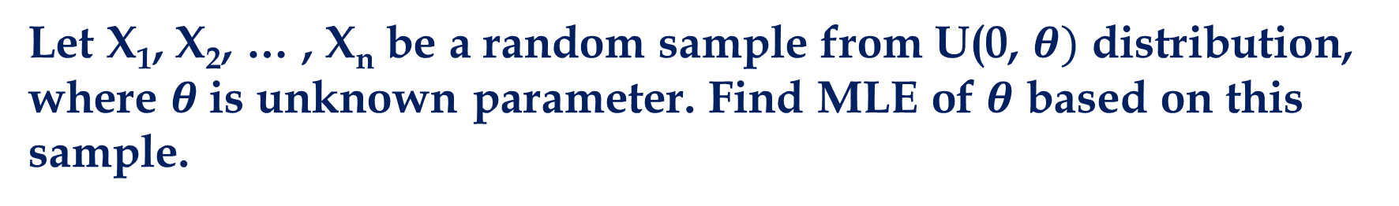
Problems
Let X₁, X₂, … , X_{n} be a random sample from U(0, $θ)$ distribution, where $θ$is unknown parameter. Find MLE of $θ$ based on this sample.

